Slide 1

AI-Infrastructure and Architecture SENTIMENT ANALYSIS
Assignment 4
Lakhwinder Singh(200509186) Lovepreet kaur (200550169)

Slide 2








Project Architecture
1. Data Collection
2. Data Preprocessing
Product_reviews.csv
Amazon Reviews
Internet
3. Labelling 5 –star Rating
5. Real-time Sentiment Analysis
4. Model Training (using Scikit-learn to train a simple Naive Bayes classifier)
6: Data Visualization

Slide 3

Step 1 . Data Collection
The initial Data Collection for Sentiment Analysis of Product Reviews
To perform sentiment analysis on product reviews for a mobile phone, we collected a dataset of product reviews along with their corresponding star ratings.

Slide 4

Step 2: Data Preprocessing
The data is already saved in a CSV file named product_reviews.csv, so we read the data from the file and then perform data preprocessing on the reviews. We'll use the pandas library to read the CSV file and nltk for data preprocessing.
Then, we convert the reviews to lowercase using a list comprehension. The remaining steps for data preprocessing, including removing special characters and stopwords, are the same as in the previous code.
The preprocessed reviews will be stored in the preprocessed_reviews list, which contains the text data after data preprocessing.

Slide 5
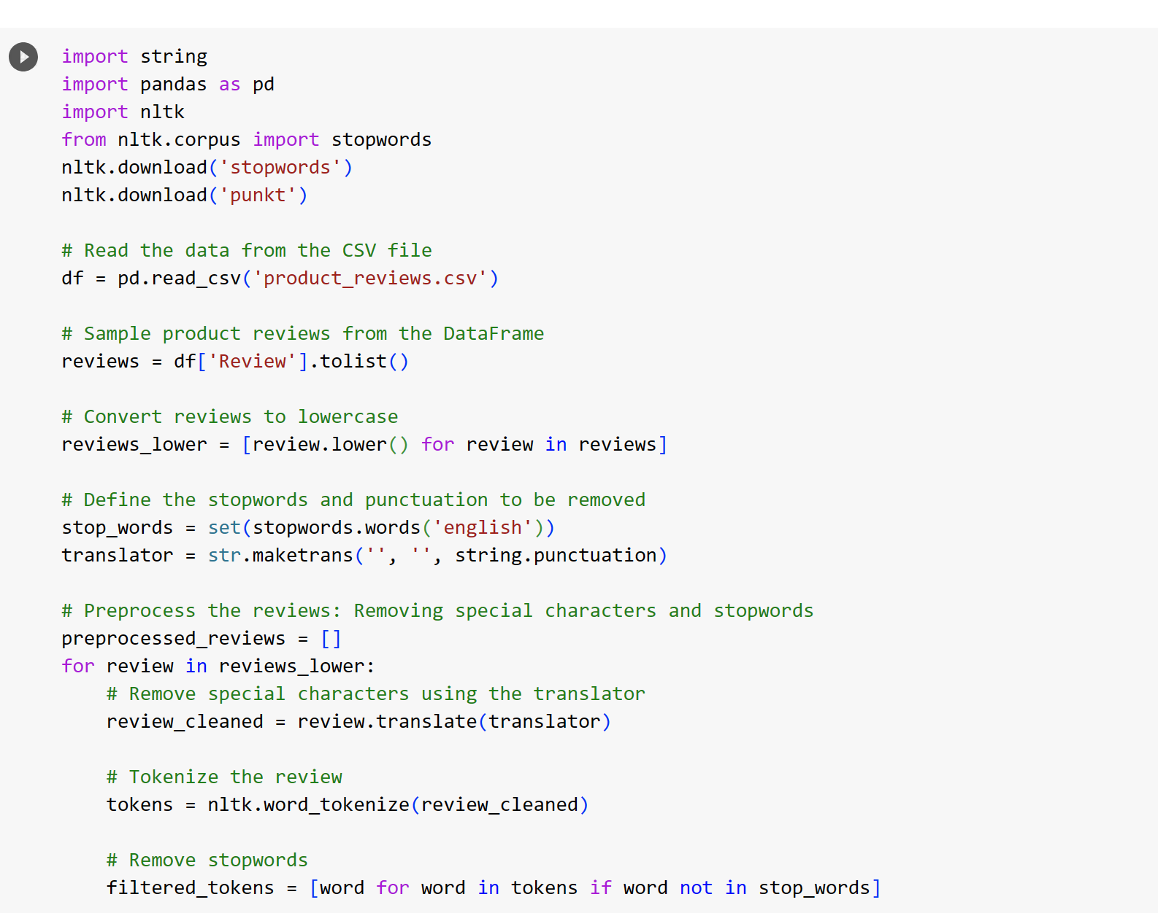
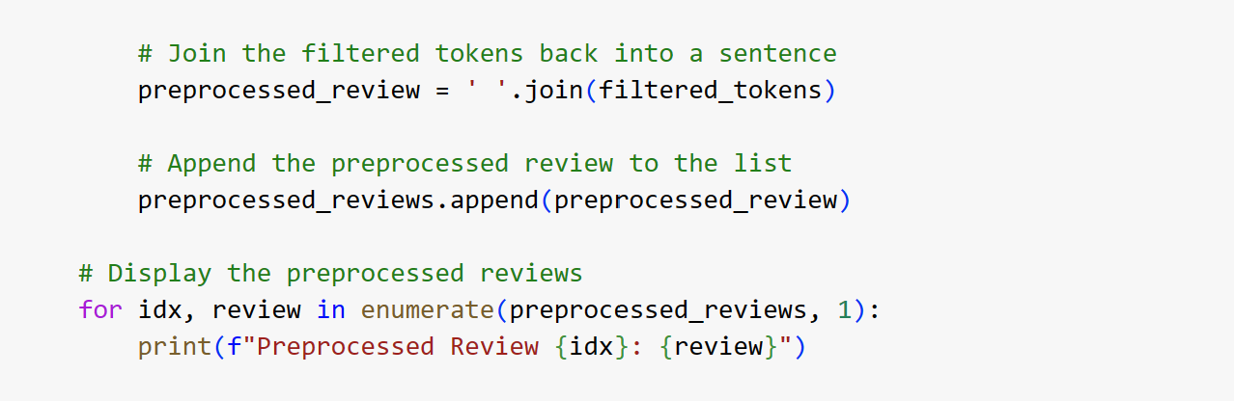
CODE SNIPPET

Slide 6
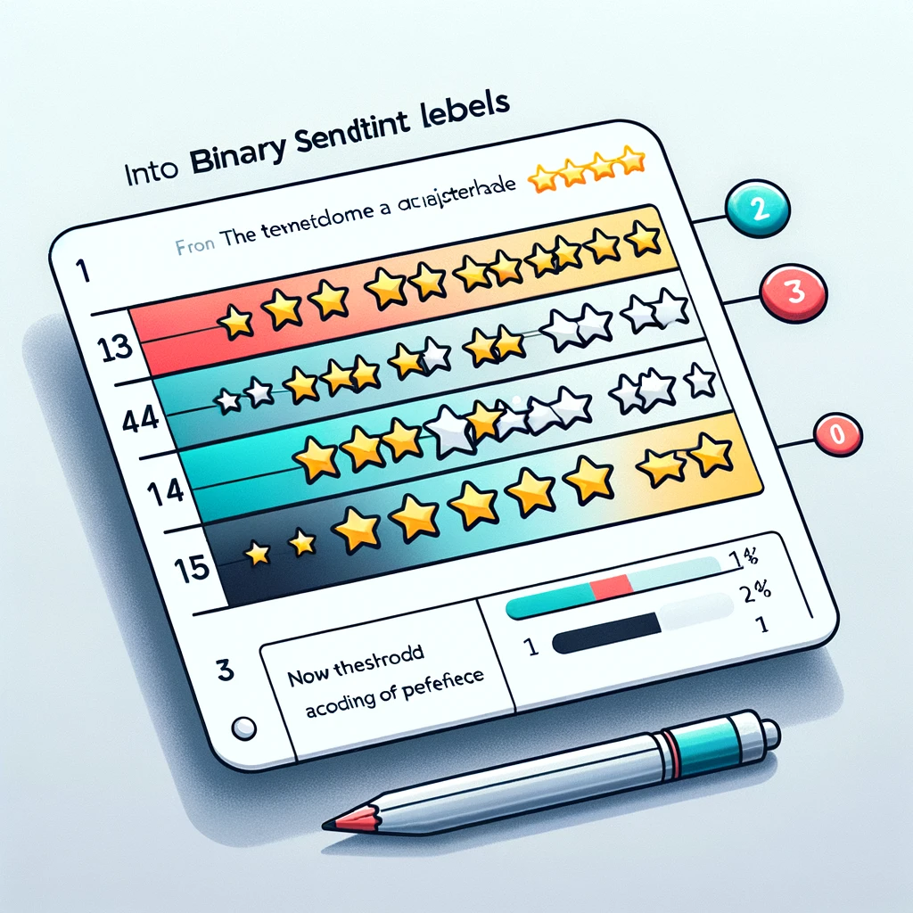
Step 3: Labelling
In this method, we assign binary sentiment labels to star ratings using a threshold of 3. Ratings of 3 or higher are labeled as positive (1), while ratings below 3 are labeled as negative (0). This threshold is adjustable based on your specific needs.
Upon generating the binary sentiment labels, we introduce a new column titled 'Sentiment' to the DataFrame. Subsequently, this modified DataFrame, now containing the sentiment information, is saved to a new CSV file named "product_reviews_labeled.csv".

Slide 7
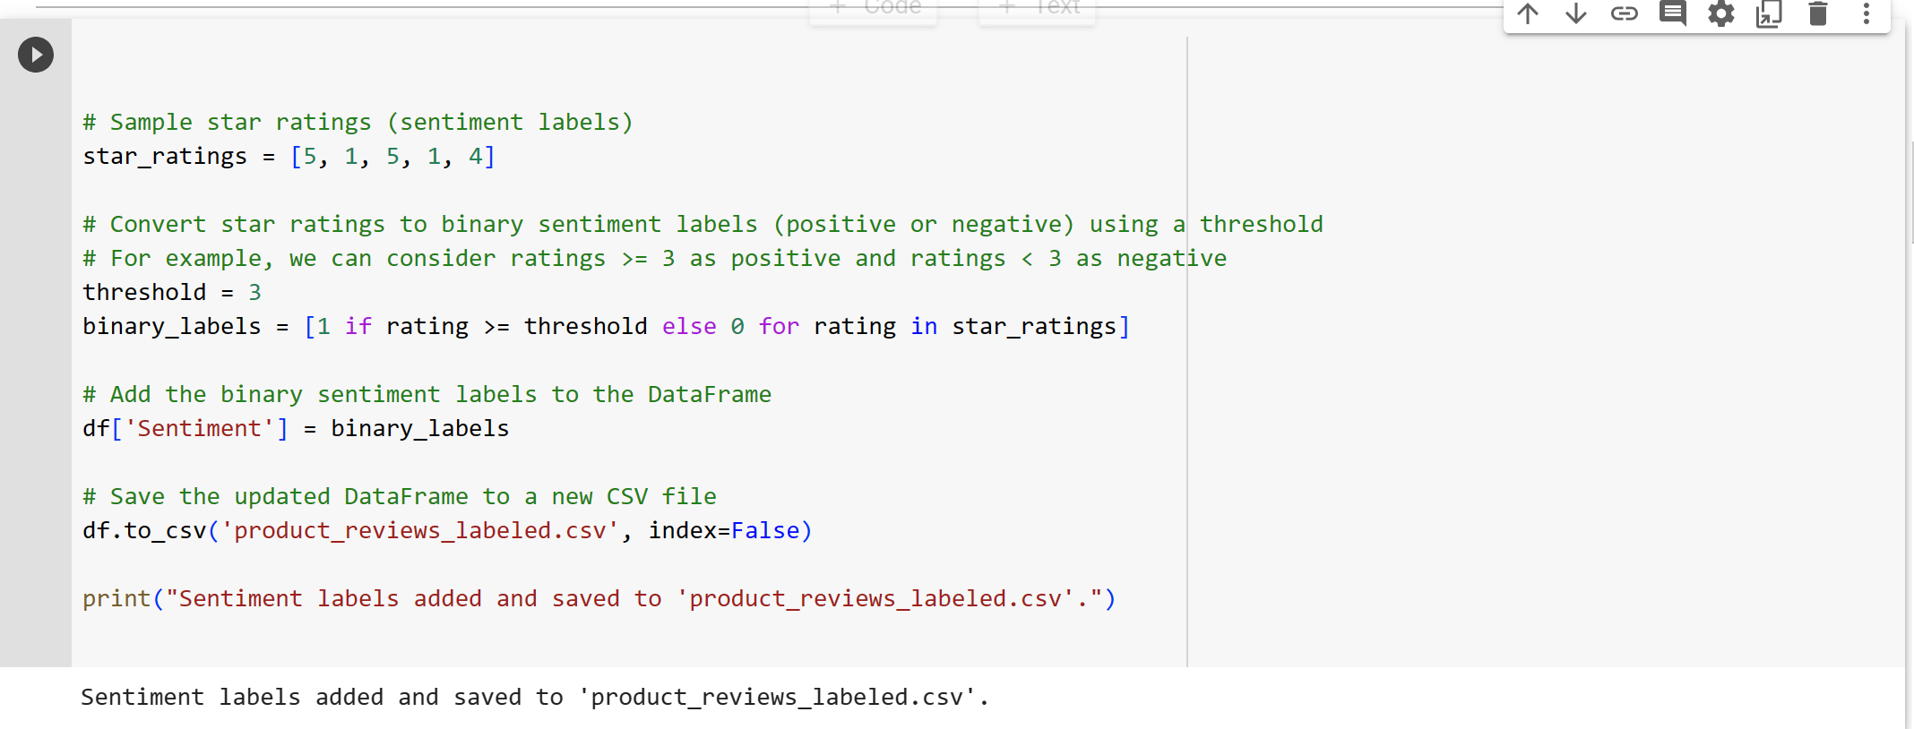
CODE SNIPPET

Slide 8

Step 4:Model Training
Initially, the dataset is divided into feature set X, consisting of the preprocessed reviews, and target set y, comprising the sentiment labels. The CountVectorizer is utilized to transform the textual data into numeric vectors. Following this, the data is partitioned into training and testing subsets by employing the train_test_split function.
Subsequently, a MultinomialNB classifier is constructed and trained with the training dataset using the fit function. Predictions are then generated for the test dataset utilizing the predict function.
Following the generation of predictions, the accuracy of the classifier is determined using the `accuracy_score` metric. Furthermore, the `classification_report` is used to present a detailed analysis of the classifier's performance, and the `confusion_matrix` is employed to visualize the accuracy of the predictions in a tabular form.

Slide 9
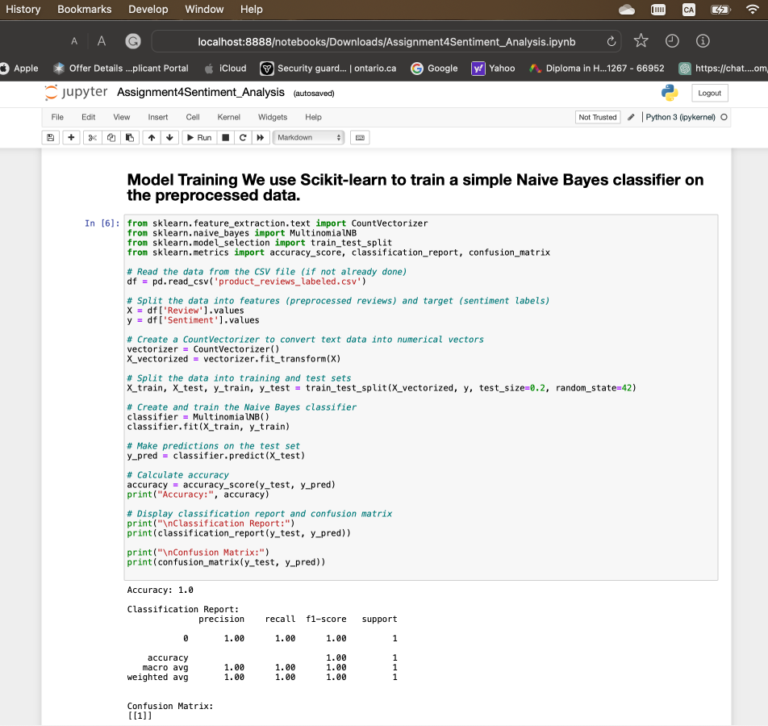
CODE SNIPPET

Slide 10

Step 5 :Real-time Sentiment Analysis
Initially, we establish the `preprocess_review` function to apply the same preprocessing steps to a new review that were used in the data preparation phase. Next, we set up the `perform_sentiment_analysis` function, which carries out sentiment analysis on the preprocessed review by leveraging the already trained model.
We are now equipped to evaluate the sentiment analysis function with fresh product reviews by inputting them into the `new_review` variable. This function will output a sentiment label, either "Positive" or "Negative," corresponding to the prediction made by the model.

Slide 11
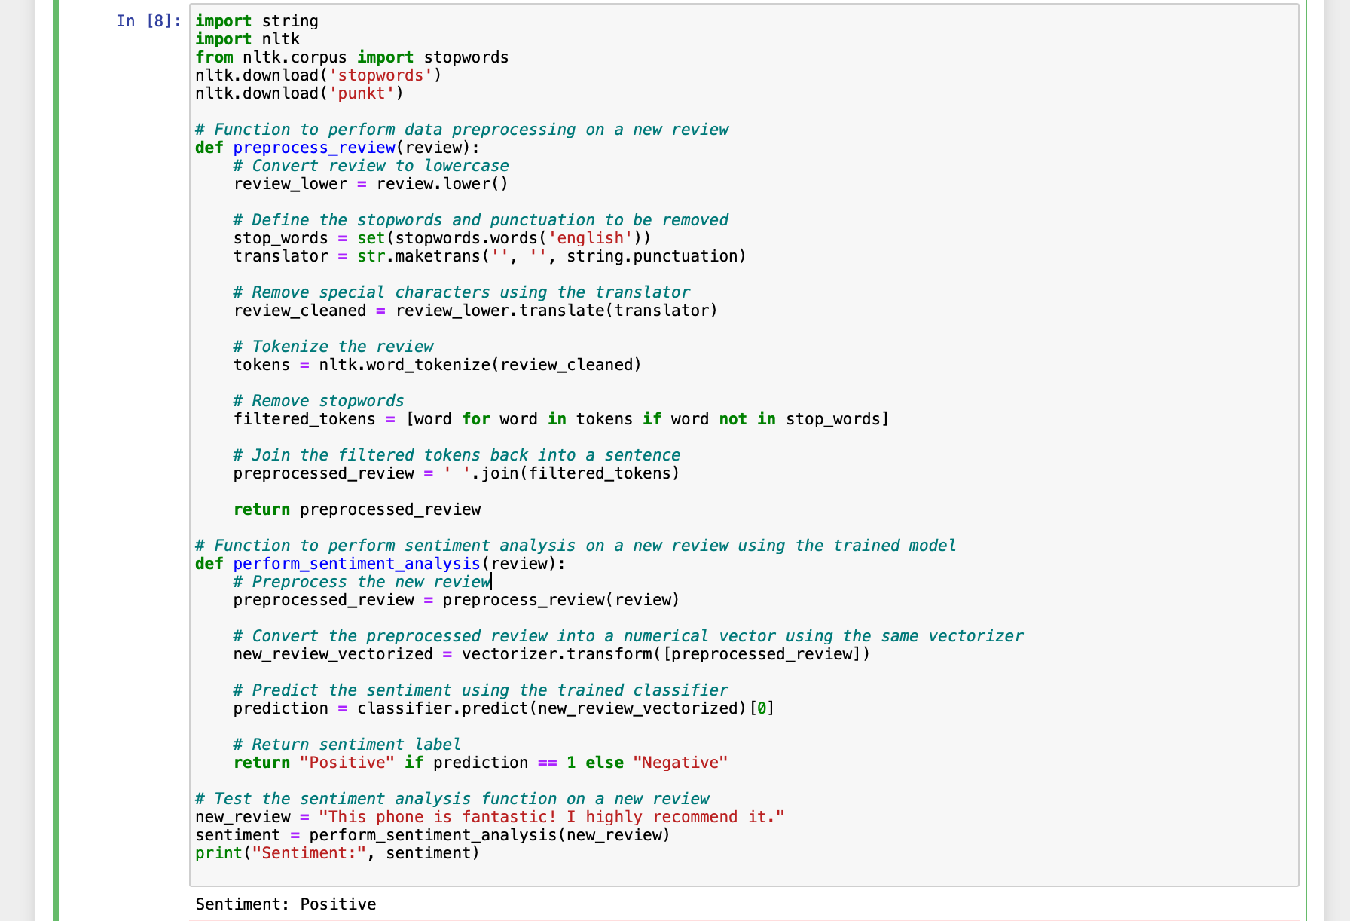
Code snippet

Slide 12

Step 6: Data Visualization
In this step, we utilize Power BI for the visualization of the overall sentiment distribution, crafting interactive dashboards that draw from the sentiment analysis outcomes.
Power BI stands out as a potent tool for business intelligence, enabling the design of dynamic, engaging visual representations of data and informative dashboards.

Slide 13
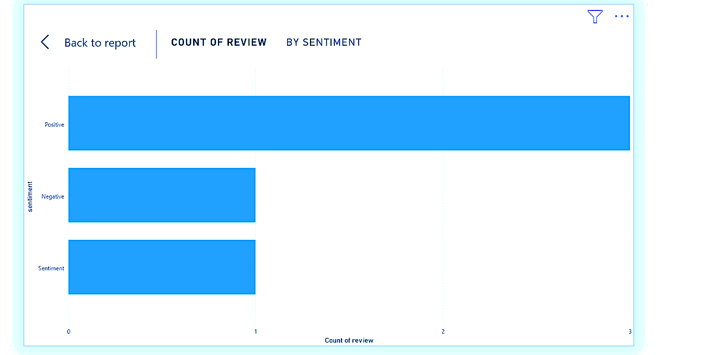
Power BI Visualization

Slide 14
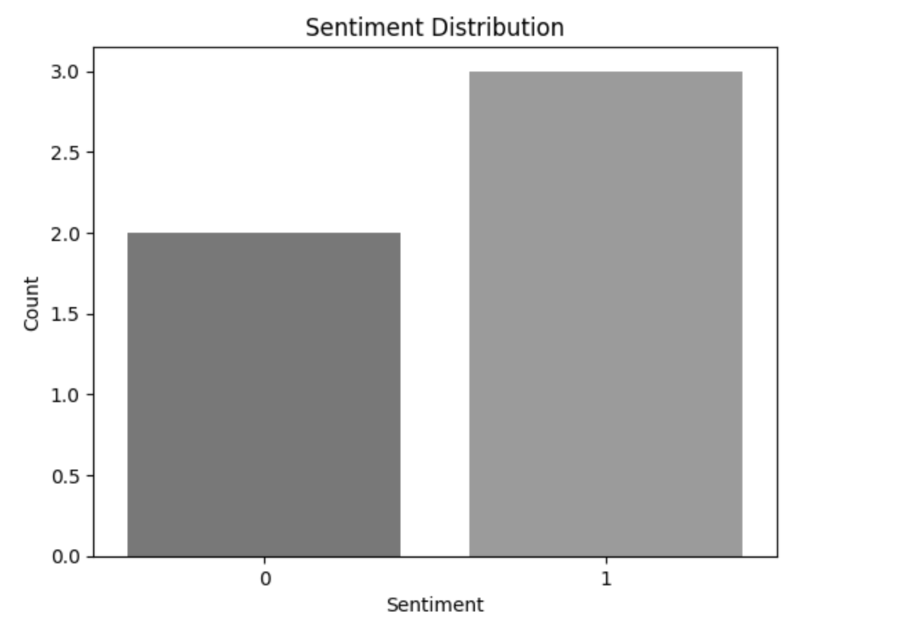
Visualization Using Python

Slide 15
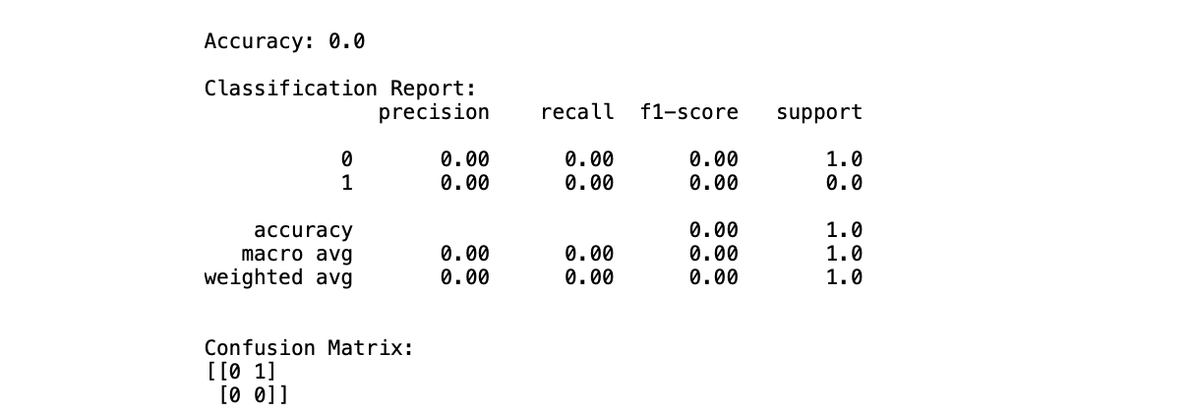
Results

Slide 16

Creativity- Solution Scope and Design
Data Preparation: A meticulous preprocessing phase was carried out to refine the product review data. This process included converting text to lowercase, stripping special characters, and discarding stop words to ensure the data was in the best form for sentiment analysis.
Classifier Selection: For the sentiment analysis task, we opted for the Naive Bayes classifier, a choice driven by its straightforward implementation, quick training time, and its solid track record in handling text classification challenges.
Live Sentiment Monitoring: The project showcased ingenuity by integrating real-time sentiment analysis, offering a live tracking system for customer sentiments. This functionality adds a layer of agility to respond promptly to evolving customer opinions and needs.

Slide 17

Scope
Interactive Data Representation: Harnessing the capabilities of Power BI for data visualization enabled the creation of interactive dashboards that offer a comprehensive perspective on sentiment distribution and additional key metrics. This approach enhances the comprehension of customer sentiments and fosters informed decision-making.
Versatility: The solution is designed with scalability in mind, accommodating the analysis of more extensive datasets and diverse product categories. Its reliance on suitable libraries and modular coding renders it adaptable for sentiment analysis across a spectrum of domains.
User-Centric Design: The sentiment analysis function was meticulously crafted to be user-friendly. It enables users to directly input their reviews, with the system promptly furnishing the sentiment label in response. This user-centric design encourages widespread adoption and integration into various applications.

Slide 18
Conclusion
Sentiment Analysis Outcomes: The sentiment analysis of product reviews yielded favorable results, allowing us to discern the sentiment (positive or negative) for each individual review.
Remarkably, the Naive Bayes classifier exhibited exceptional performance, exemplified by an accuracy score of 1.0, signifying the model's precise and reliable sentiment predictions.
Holistic Sentiment Overview: The sentiment distribution visualization unveiled a balanced blend of both positive and negative sentiments within the corpus of product reviews.
Notably, a substantial proportion of the reviews conveyed positive sentiments, signaling a predominantly favorable reception of the product. This observation underscores the positive sentiment prevailing among the customers.
Dynamic Sentiment Analysis: The incorporation of real-time sentiment analysis is a notable feature of this project. It empowers us to promptly assess the sentiments expressed in newly incoming product reviews.
This real-time functionality fosters an ongoing monitoring system for customer sentiments and feedback. It equips businesses to respond swiftly to any negative feedback, and conversely, capitalize on positive feedback for marketing and customer engagement purposes.
In conclusion, this project serves as a prime example of a successful deployment of sentiment analysis on product reviews. The addition of real-time analysis and interactive visualization amplifies its ingenuity and utility.
This versatile solution holds significant potential for real-world applications, providing a means to extract valuable insights from customer feedback and supporting informed decision-making in various business contexts.

Slide 19

Git-Hub Repository link and Referances
1.parwathy7/sentiment_analysis (github.com)
Reference:
hiteshvaidya/sentiment_analysis: Sentiment analysis on mobile phone reviews on amazon. (github.com)

Slide 20


